Slide 1


Exploratory Data Analysis in Python
06.13.2022
EDA

Slide 2












Agenda
Why EDA
What is EDA
When to use EDA
How to perform EDA
Useful Python packages
Support & Questions

Slide 3
What is Exploratory Data Analysis (EDA)?
Exploratory data analysis refers to the critical process of performing initial investigations on data to discover patterns, to spot anomalies, to test hypothesis and to check assumptions with the help of summary statistics and graphical representations.

Slide 4
Goals of Exploratory Data Analysis (EDA)?
Identifying the most important variables/features in your dataset.
Testing a hypothesis or checking assumptions related to the dataset.
Check the quality of data for further processing and cleaning.
Deliver data-driven insights to business stakeholders.
Verify expected relationships exists in the data.
Find unexpected structure or insights in the data.

Slide 5
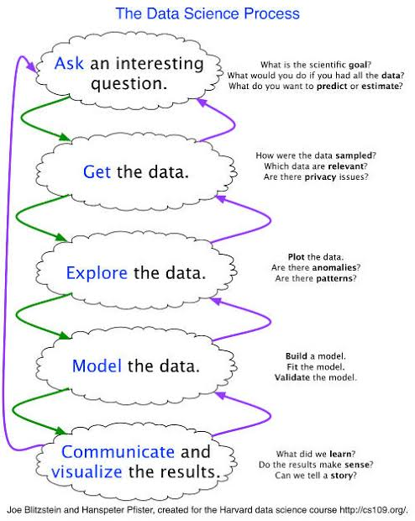
When do we perform EDA?

Slide 6
Data is not objective
Measurements and observations are not theory- or assumption-free
There’s more than one way to build a (statistical) model of any data set
While the data may support a theory, they likely support many other theories
While a data set may support a theory, it could also contain relation that are contradicting the theory
Even if your data is carefully selected and measured, and you think you know it well, it is important to look for the unexpected!

Slide 7
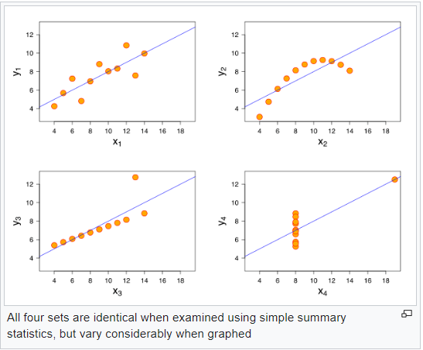
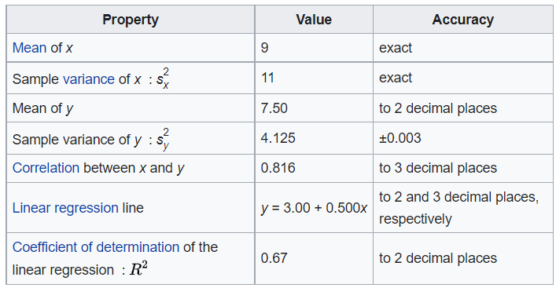
Visualization is vital
Anscombe’s Quartet

Slide 8
Stay open to multiple interpretations
The confirmatory, or hypothesis-testing mode, to data science can
keep one from seeing what other patterns might exist in data.
In addition to asking:
Do these data confirm or disconfirm my hypothesis about x?
Ask:
What can these data tell me about x?

Slide 9
Common Things to Check
Column types
Common values
Anomalies/outliers
Missing values
Summary statistics (mean,median,count)
Duplicates
Correlations
Useful Functions
df.head()
df.info()
df.describe()
df.duplicated([‘column_name’])
df.isnull().sum()
df.iloc[df[‘column_name'].idxmin()] / df.iloc[df[‘column_name'].idxmax()]
df.corr()
df.profile_report()

Slide 10
Missing Values
Missing completely at random (MCAR)
“the dog ate my homework”
Missing at random (MAR)
Missing not at random (MNAR)
Important to investigae

Slide 11
Core Packages
https://pandas.pydata.org/
https://numpy.org/
Visualization Packages
https://matplotlib.org/
https://seaborn.pydata.org/
Automation Packages
GitHub - ydataai/pandas-profiling: Create HTML profiling reports from pandas DataFrame objects
GitHub - fbdesignpro/sweetviz: Visualize and compare datasets, target values and associations, with one line of code.
GitHub - AutoViML/AutoViz: Automatically Visualize any dataset, any size with a single line of code.

Slide 12
SUPPORTING Resources
https://www.datacamp.com/courses/exploratory-data-analysis
https://towardsdatascience.com/exploratory-data-analysis-in-python-c9a77dfa39ce
https://www.coursera.org/lecture/data-analysis-with-python/exploratory-data-analysis
https://www.kaggle.com/kashnitsky/topic-1-exploratory-data-analysis-with-pandas
https://www.kaggle.com/ekami66/detailed-exploratory-data-analysis-with-python

Slide 13


Thank you!
Let’s look at some code.

